Slide 1
https://musigma.webex.com/join/hetal.assar
Point of View on Digital Personalization for
a leading snacks and beverage company

Slide 3

Why are we here?
To showcase Mu Sigma’s Trade capabilities in Digital Personalization
To discuss on engagement with Mu Sigma

Slide 4



Our journey so far…
Milestone
Discussion on strategic priorities for Digital Personalization
Understand the current work being done in Mass Personalization campaigns to more personalized media, lower costs, more effective media
Meeting with POC for understanding problem space
Nov 2017
28th Nov 2017
7th Dec 2017
18^{h} Jan, 2018
Meet Atin’s team to understand the current work being done
Understanding the goals for personalization CRM data and campaigns run
Debrief on LKC ad Ruffles Mass Personalization Campaigns
Outcomes
To be discussed

Slide 5

| Agenda
Problem space
Analytical solutions
Case studies
Examples of personas for a financial services client

Slide 6


Client's ROI and competitive advantage in the space of Digital Personalization has a scope for improvement
Gaps
Understanding how attributes of digital media campaigns can be personalized for different target audience to increase response
Current State
Future State
The Media Marketing team at Client is responsible for building strategies to improve consumer experience and marketing efforts across the digital portfolio
Currently, themes and offers from a pool are prioritized manually using business intuition, thus lacking personalization at consumer level
In order to improve response, Client wants to target consumers through personalized digital media campaigns
Outcome: There is an increase in digital marketing ROI and ultimately overall revenue via campaigns
Behavior: Client has developed a framework based on personalization algorithms to personalize digital media
Insights: Client has identified which attributes are most attractive for each consumer persona
Key Question
What are the different attributes of digital media campaigns that can be personalized to increase consumer response?

Slide 7

















Performing a structured problem split for the problem of Digital Personalization
Customer Need State
Content Strategy
Channel Strategy
Suitable time for customer touch base
`
Duration b/w 2 touchpoint
Demographic
Browsing Pattern
Content
Design
Email
Application
Delivery Time
Occasions
Website
Themes
SMS
Frequency of touchpoint
Purchase Pattern
Price
Offers
Customer Care
Promotional programs
Number of touchpoint
Preferred
Ingredients
Journey Oriented
Image Processing Engine
Digital Channel Mix
Customer Intimacy
Foundation Blocks
Test & Learn Framework
Attribution Model
Data Management Framework
Automation

Slide 8
| Agenda
Problem space
Analytical solutions
Case studies
Examples of personas for a financial services client

Slide 9
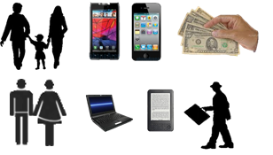
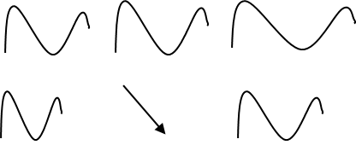


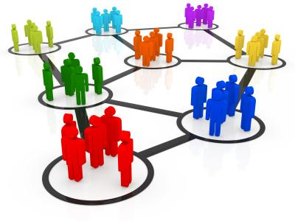


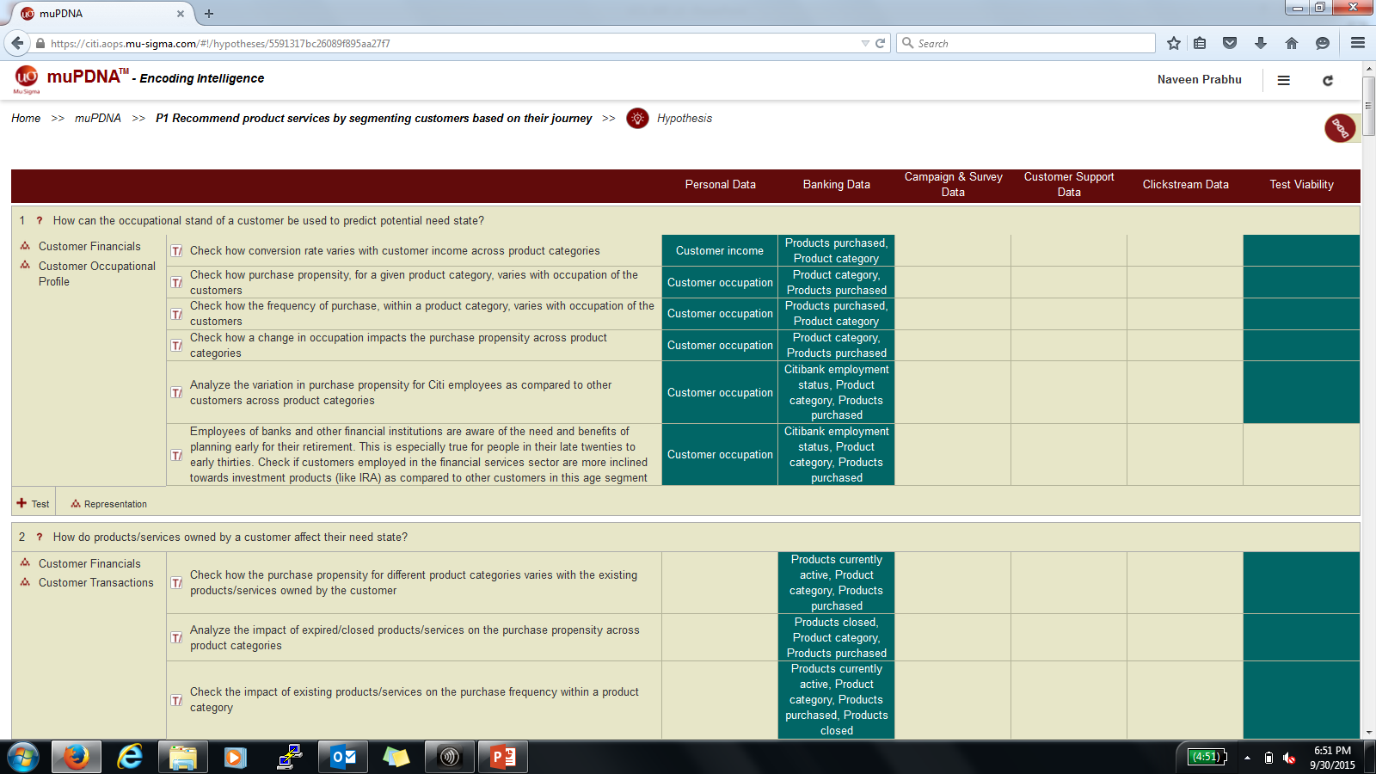

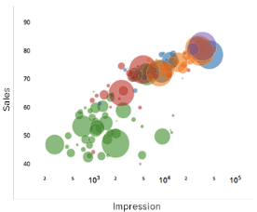



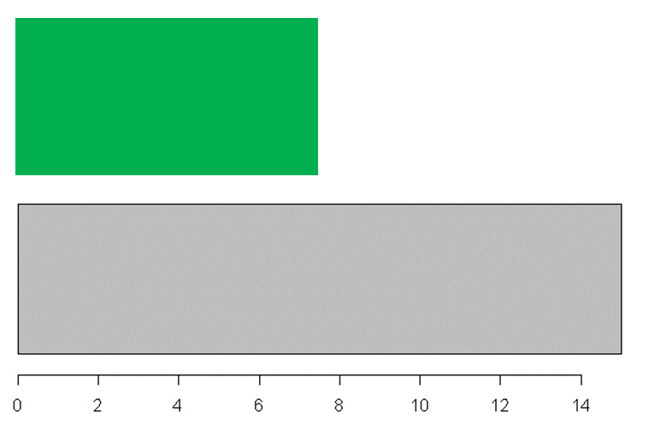

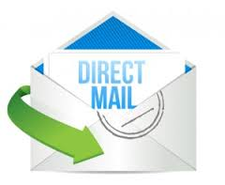
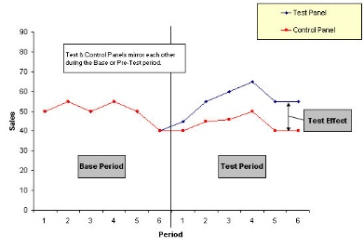

Customer Need States are recognized and mapped to the longitudinal, transactional and digital behavior of the customers
Feature Extraction
Using Hypothesis and Factor Buckets in the muPDNA to identify features that need to be extracted
Young & Hungry
Family Fun
Party
Couple's Unwind
Fuel your day
Enjoy & indulge
Behavioral Segments
Creating Behavioral Segment by leveraging the significant list of variables
Pattern Detection
Based on data exploration and hypothesis in the muPDNA, we have identified distinct patterns with significant population in the data
Midlife treat
Healthy Enjoyment
Product Back-testing
For each of these patterns, identified adoption rate across different product lines
CHK ?
SAV ?
CKP ?
CCL ?
PL ?
HELOC ?
Test & Learn
Setup Test & Control sets to roll-out offers and establish feedback loop which goes in as an input to the framework

Slide 10
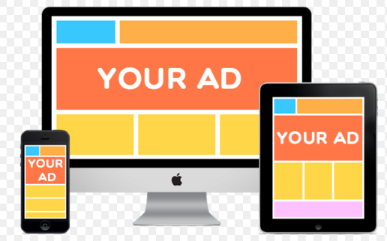




The impact period of each trigger and ad content-emotion mapping is identified in order to disp relevant advertisements
Impact Period Identification
Each trigger invokes an emotion in the viewer only for a specific period of time depending on the type of trigger
The time frame which has the maximum percentage of online activity for the trigger is the most ideal impact period for the trigger
The number of visits to the article/story is broken down to an hourly level and then the timeframe until when most traffic is encountered (80%) is chosen as the most impactful time frame
Ad content:
Advertisements are categorized based on content. For example:
Empathizing: Content that empathizes with the emotion of the viewers
Escapist: Content that helps viewers escape from their current emotional state
Catalyzing: Content which leveraged viewer’s current emotions and escalates it to a higher level
Diminishing: Content that helps reduce the intensity of viewer’s current emotion

Slide 11
Test and control groups are identified to target customers based on need state
X consumers
C1
T
Occasion based
C6
C
Y consumers
C2
T
Test and control groups are identified and creative designs are recommended
Test Group
Preferred flavors
C6
C
Targeted Customer Base
Z consumers
C3
T
Product launch - Demographic
C6
C
CRM Data
~11 M (leading snacks and beverage company-)
~60 M (Client)
Control Group
C4
T
Rest of the Customers
C5
T
C6
C

Slide 12

We identify preferred digital and traditional channels by customers across segments
Promotions/Coupons
Marketing associates
Account executives
Consumers
Advertisements
Client
Online
Traditional
Consumers
Disp
Search
Email
Mobile app
Re-targeting
Video
Conference
Trade show demo
Own website
Social media
Content
Phone calls
Partner
Mail
TV/Radio
Public relations
Print ads
Physical events
Analyze interactions of customers across various channels, develop sales and marketing strategies to continuously fine-tune promotional efforts
Identify suitable channels that is preferred by customers across segments

Slide 13


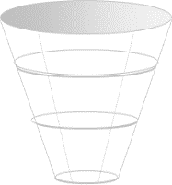
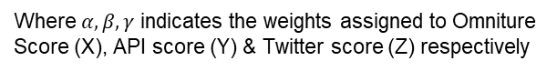
Suitable occasion and timing for customer touch base - appropriate triggers are identified and ranked based on their frequency and popularity
# visits, page views, # distinct visitors
Examples of Triggers:
Hunger pang after long day of work
Missing lunch break side
Long drive snack requirement
Stress-busting snack
etc.
CRM
seasonal occurrence
Exhaustive list of triggers
Triggers for analysis
API
Final Score = $(α∗X)+(β∗Y)+(γ∗Z)$
twitter mentions
Where $α,β,γ$ indicates the weights assigned to Omniture Score (X), API score (Y) & Twitter score (Z) respectively
Twitter
Trigger List
CRM Scores
API Scores
Twitter Scores
Final score
An exhaustive list of triggers based on various events that could occur during games are identified
Triggers are selected from all sources - CRM, API ,twitter etc.
All the trigger data obtained is rolled up either on a persona level
The number of trigger data and other metrics available are then averaged to get a single number (rank) for each metric
Headlines, Scores & Schedules, Standings, Teams, Leaders and Athletes APIs are used to provide frequency scores and information
Seasonal occurrence is calculated by # occurrences of various triggers from API data by filtering for specific keywords
Various keywords are used to search for the tweets talking about the trigger
The twitter score for a trigger is calculated using the number of mentions for the particular trigger
The ratio of weights is calculated for all the triggers and the final weight (𝜶,𝜷,𝜸) is calculated by aggregating the ratio of scores for all the triggers

Slide 14
| Agenda
Problem space
Analytical solutions
Case studies
Examples of personas for a financial services client

Slide 15












For a leading airlines, we determined that optimization of email features specific to customers need state will help improve the response rate
Offer
Travel Pattern
Design
Segments
Content
Delivery
Product
Browsing Behavior
Customer Attributes
Email Features
Content | Offer, Products, Subject line, Sender ID, etc. | Identify relevant offers based on Customer location Custom upsell/cross sell email based on Booking pattern analysis Browsing pattern Analysis to determine relevant Product offering
Design | Template, No. of Banners, Banner features, etc. | Identifying features that work best by Customer segments
Delivery | Frequency, Right target time by Campaign, etc. | Saturation Analysis using browsing behavior to identify optimal frequency of emails Browsing & Booking pattern Analysis to identify favorable delivery time

Slide 16

Mu Sigma worked with a leading airlines to deliver value in multiple work streams
We customized IPE capability for the airlines and leveraged it to design the banners in our Email optimization project
Current segments are not suited for Content Personalization as there is no significant variation in response behavior for existing Customer segments
Designed customized Holiday campaign – incremental value of $ 182K in 10 days of campaign release – overall potential of ~$14 MM
7
Banner Features were extracted
~85%
Average accuracy was achieved
~10
New features will be implemented by end of January 2018
Image Processing Engine
6
Creatives were designed using IPE recommendations
~7.2%
Incremental lift in CTO is observed
$ 182K
Incremental revenue is observed in 10 days of campaign
Holiday Campaign 2017

Slide 17




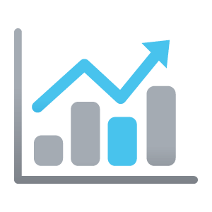
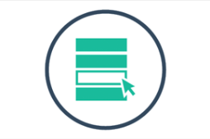
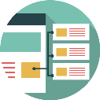
For a leading sports wear company, we created a personalized intent-purchase propensity solution
WHAT
DATA
Purchase Propensity Model is a type of predictive model that allows to identify which consumers are more likely to make a purchase in the next 7 days from client in a particular product category
√ | Profile | √ | Signup
√ | Purchase | √ | Subscription
X | Retail Sales | √ | Campaigns
√ | Browsing | √ | Cart
√ | Email | X | Reviews
X | Social
Football
Originals
Stella
Neo
…
0%
75%
30%
3%
…
Consumer DNA
Purchase Propensity Model
Probability to purchase
Champion category
WHY?
USE CASE
Increase conversion rate by targeting consumers across channels like social, web, email etc. who are likely to buy in the next 7 days
CONSUMERS THAT ARE TARGETED IN THE CATEGORY RECOMMENDED BY PURCHASE PROPENSITY SCORE MODEL HAVE A HIGHER CONVERSION
PPS IS CHANNEL AGNOSTIC
Trigger based targeting showcasing the most relevant content based on the champion category suggestion in which consumer shows highest probability of purchase
Personalize content recommendations with category allocation based on consumer’s highest probability of purchase

Slide 18
| Agenda
Problem space
Analytical solutions
Case studies
Examples of personas for a financial services client

Slide 19

Detailed Profiles
Affluent (A%); Emerging Affluent (B%); High Net Worth (C%); Mass Market (D%)
Average Joes (X%)
Typical customers, all of whom have a Checking Account with bank. Around X% also have a Savings Account.
They make around E transactions every month of $X each. X% are in ATMs and X% are through a branch. Every month ~$X is credited to their accounts, of which around X% gets debited in the same month
They use their accounts to make roughly W bill payments each month, totaling to ~$X
They visit the website (CBOL) P times every month and generate an average revenue of $X per month

Slide 20

Detailed Profiles
Affluent (A%); Emerging Affluent (B%); High Net Worth (C%); Mass Market (D%)
Traditionalists (Q%)
Half the customers in this segment have both a Checking & Savings Account with Client
These customers on an average make P transactions, of $X each, every month. X% of these transactions are through Client Branches, which is K times the overall average. However, over J months, this segment has observed a X% decrease in these transactions. Each month X% of the amount that is credited remains in their accounts
Most customers make a bill payment of $X
every month
This segment as a whole has around B CBOL visit every month and generates a revenue of $X per month

Slide 21

Detailed Profiles
Affluent (A%); Emerging Affluent (B%); High Net Worth (C%); Mass Market (D%)
Minimalists (M%)
All the customers in this segment have a Savings Account, while only X% have a Checking Account
These customers on an average make Q transactions, of $X each, every month, which is the lowest for any segment. X% of the transactions these customers make are through Client branches , X% using ATM and X% using CBOL which is the lowest of any segment. Although the amount credited to the accounts every month is small, X% is debited (lowest among segments)
Most customers don’t use bill payment. Those who use make a payment of $X (again the lowest). These customers have the least digital presence, with around L visit every Q months and generate $H revenue per month

Slide 22

Detailed Profiles
Affluent (A%); Emerging Affluent (B%); High Net Worth (C%); Mass Market (D%)
Active (C%)
All the customers have a Checking Account and over X% have a Savings Account as well
These customers make almost C transactions every month, which is W-fold the overall average. Nearly X% of these transactions are debit transactions. Each transaction is of roughly $X which is near the overall average
On an average, they make P bill payments every month, totaling to $X, which is almost E times the overall average
These customers are also highly active online, with ~L CBOL visits every month. This is also reflected by the fact that X% of the overall transactions are non-financial. However, they generate an average revenue of $X per month

Slide 23

Detailed Profiles
Affluent (A%); Emerging Affluent (B%); High Net Worth (C%); Mass Market (D%)
On the Go (Q%)
X% of these customers have a Checking Account and X% have a Savings Account with Client.
At E transactions a month, they have the second highest number of transactions across segments. However, their transaction amount is quite low at $X. X% of the transactions are through ATMs, which is K times the overall average. Around $X is credited every month, W/A^{h} of which is debited in the same month. Behavior resembles that of college students.
Most customers make bill payment of a little below $X
Visit the Client website once every month & generate relatively low revenue of $X per month

Slide 24

Detailed Profiles
Affluent (A%); Emerging Affluent (B%); High Net Worth (C%); Mass Market (D%)
High Potential (B%)
Over X% of the customers have a Checking Account and Savings Account each and X% have both
They make D transactions a month (a little below average), but of significant transaction amount – $H per transaction. X% of these transactions are through CBOL, which is Q times the overall average. At $F these customers have the highest monthly credited amount to their accounts, of which little over X% is debited in the same month
They make more than R bill payment every month of $P, which is twice the overall average
They are highly active online with L visits every month on the Client website. They generate the highest revenue of $F per month

Slide 25
Thank You!

